Slide 1
Determinants of noun classification in Kîîtharaka: A synchronic approach
Patrick Kanampiu¹, Alexander Martin², Jennifer Culbertson¹
¹University of Edinburgh, ²University of Paris
9th Conference on Bantu Linguistics
7th -10th June,2022

Slide 2
Noun class systems
Nouns grouped based on agreement (Hockett 1958, Corbett 1991, Katamba 2006)
Used interchangeably with gender (Corbett, 1991:1; Aikhenvald, 2006)
Kîîtharaka
(1) | mûthaka | ûra
 | 1.young man | 1.dem.dist
(2) | kîbanga | kîra
 | 7.machete | 7.dem.dist
(3) | ibanga | bira
 | 8.machete | 8.rel
French
(4) | le | vieil | homme | homme
 | Det.M | old.M | man.M | man.M
(5) | la | camionnette
 | Det.F | van.F

Slide 3
What determines noun class in a language?
Semantics
Form of the noun (morphology and/or phonology)
Kîîtharaka
(1) | mûthaka | ûra
 | 1.young man | 1.dem.dist
(2) | kîbanga | kîra
 | 7.machete | 7.dem.dist
(3) | ibanga | bira
 | 8.machete | 8.rel
French
(4) | le | vieil | homme | homme
 | Det.M | old.M | man.M | man.M
(5) | la | camionnette
 | Det.F | van.F
semantics
(human)
semantics
(male)
morpho-
phonology
(kî-kî/kî/i)
morpho-
phonology
(-ette)

Slide 4
What determines noun class in a language?
Discovering exact set of features that determine noun classification in a given language is an intricate affair!
Typically, many exceptions…
Kîîtharaka
(6) | mûthaka | ûra
 | 1.young man | 1.dem.dist
(7) | kîroria | kîîra
 | 7.prophet | 7.dem.dist
(8) | îthe | mûkûrû
 | 5.father | 1.elder
French
(9) | le | vieil | homme | homme
 | Det.M | old.M | man.M | man.M
(10) | la | personne
 | Det.F | person.F
(11) | la | camionnette
 | Det.F | van.F
(12) | le | squelette
 | Det.M | skeleton.M
semantics
(human)
semantics
(male)
?
?
morpho-
phonology
(-ette)
?
?

Slide 5
Theoretical and empirical questions…
How do we know what semantic or morpho-phonological cues are productive amidst such exceptions?
Do speakers treat different types of cues the same way? (e.g., Karmiloff-Smith, 1981; Perez-Pereira 1991; Gxilishe et al., 2009; Gagliardi & Lidz 2014 a.o)
Required:
  A theory of productivity
  Empirical evidence for speakers’ use of different cues.
Have these questions been answered by traditional approaches to Bantu noun classes?

Slide 6
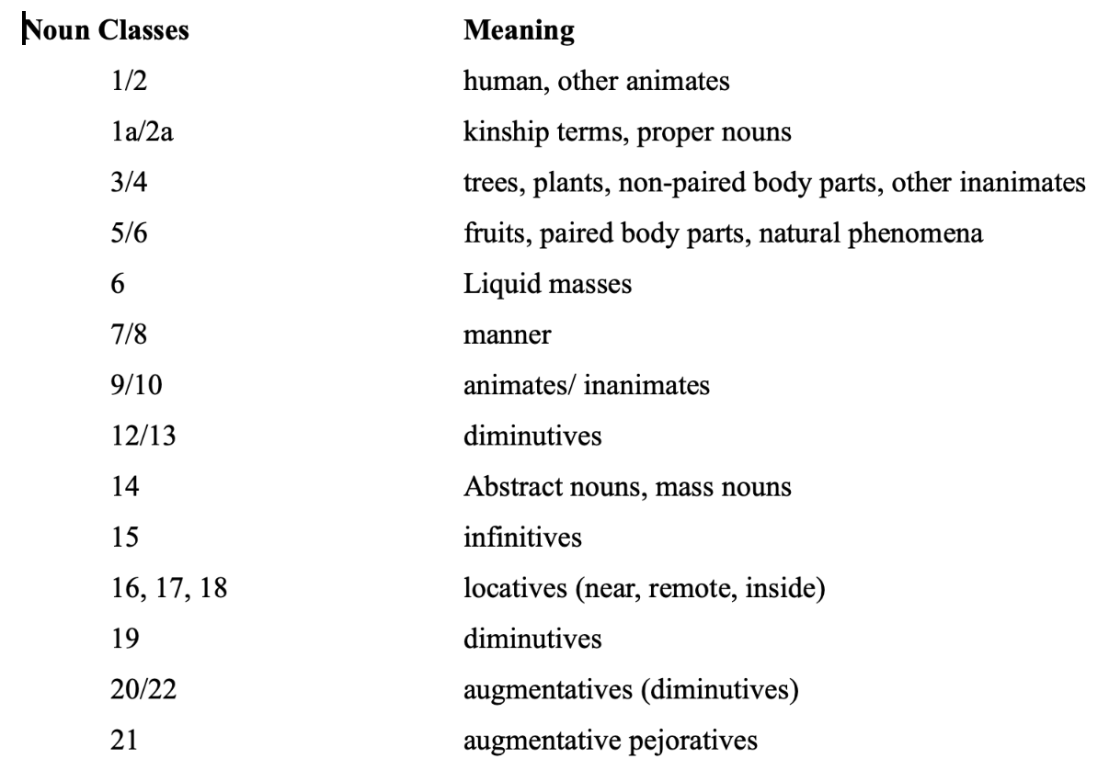
Traditional approaches to Bantu noun classes
The Proto-Bantu System
(Richardson, 1967; Welmers, 1973)

Slide 7
Traditional approaches to Bantu noun classes
  Key Features:
  Classes marked by the prefix (rather than agreement) – problematic
  Centred on semantics – problematic (whether meaning is on the
  nominal stem or prefixes)
Swahili (Carstens 1991)
(13) | kifaru | mdogo
 | 7.rhino | 1.small
Kîîtharaka (corpus data)
(14) | nkoma | athi
 | 9.devil | 1.went

Slide 8
Traditional approaches to Bantu noun classes
  No theory for saying what makes something productive!
  No evidence that speakers find these things productive!
  A different approach:
    quantitative corpus ( e.g., Ngcoco, 2010 (Zulu); Msaka, 2019 (Chichewa).
    psycholinguistic experiments with speakers (e.g., Jarro et al, 2021 (Kinyarwanda).
    Ideally both corpus and psycholinguistic experiments (the current study).

Slide 9
A different approach to Kîîtharaka
The study aims to establish productive rules that determine noun class membership in Kîîtharaka:
  Corpus analyses using Tolerance Principle (Yang, 2016) (plus native speaker intuitions) provides predictive rules for class assignment.
  Run psycholinguistic tests – will show what speakers pay attention to.
  Includes testing the relative importance of semantic and morpho-phonological cues (following e.g., Karmiloff-Smith, 1981; Gagliardi & Lidz 2014, and others).

Slide 10
Building a Corpus
The study uses a corpus – Currently (2328 nouns)
~1000 collected from Kîîtharaka bible and,
~1300 translated from SIL comparative African Wordlist (Snider
and Roberts, 2006).
  Coded for singular/plural agreement, semantics and morphophonological features (prefixes).

Slide 11
Corpus Analysis
Corpus analysed for rule productivity using Tolerance Principle (TP) (Yang, 2016)
Tolerance Principle demonstrates how to establish the productivity of rules with exceptions.
  provides a threshold beyond which the exceptions should not exceed for the rule to be productive.
    Makes use of 2 integer values N (number of items in the lexicon) and e (number of items not obeying the rule)
  Let a rule be defined over a set of N items.
  The rule is productive if the number of exceptions does not exceed a threshold, 𝛉_{N.}
  exceptions ≤ 𝛉_{N} = N/ln(N) (Yang, 2016)

Slide 12
An overview of Tolerance Principle (TP)
TP offers a mechanism of establishing the productivity of linguistic rules in a set of items with exceptions by providing a threshold beyond which the exceptions should not exceed for the rule to be productive.
  Let rule R be defined over a set of N items. R is productive if and only if e the number of exceptions does not exceed 𝛉_{N.}
  (e ≤ 𝛉_{N} = N/ln(N) (Yang, 2016)
The threshold (Theta_N) is an expression of the time complexity involved in processing all the items in a non-productive rule. e.g, in a list of 100 items with 10 exceptions, the time taken is expressed as:
Productive rule = T (N, e) = T(100, 10)
Unproductive rule= T(N,N) = T(100, 100) (takes more time- each item is accessed and listed)
TP borrows substantially from two previous theories:
The Elsewhere Condition (Anderson, 1969; Aronoff, 1976)
  Exceptions are processed earlier than regulars
  Serial search- frequency sensitive (Stermberg, 1969; Forster, 1976)
Zipf’s Law (Zipf, 1949)
  Yang uses it to derive the tolerance threshold (A function of probability and time needed to access all items in a non-productive rule)
  The law states: The rank (r_{i}) and the frequency (f_{i}) of a word (w_{i}) in a corpus of natural language are inversely proportional (r_{i}f_{i} = C).

Slide 13
Semantic features coded for
Target Class | Semantic Feature(s)
1/2 | (super)human
3/4 | Extended shape, spread shape, protruding shape, trees & plants, dispersive mass)
5/6 | Fruits, round shape, plant part, augmentative, made of wood, cohesive mass
7/8 | Artefacts, pejorative, derived
9/10 | Animals, artefacts
11/10 | Narrow things, wavy-shaped things
12/13 | Diminutives
14 | Abstract, mass
15 | Derived, infinitives

Slide 14
Morphophonological features coded for
Target Class | Morphophonological Feature(s)
1/2 | M(u)û-
3/4 | Mû-
5/6 | Î-
7/8 | Kî-
9/10 | Mb-/Mp-/Nd-/ Nt-/Nth-
11/10 | Rû
12/13 | Ka-
14 | U-
15 | Kû-

Slide 15
Results: a productive semantic feature
Semantic features | N | Class 5 | e | 𝛉_{N} | Productive?
Human | 254 | 2 | 252 | 46 | No
Augmentative | 32 | 25 | 7 | 9 | Yes
Round | 44 | 12 | 32 | 12 | No
Plant part | 47 | 6 | 41 | 12 | No
Fruit | 17 | 8 | 9 | 6 | No
Made from wood | 12 | 1 | 11 | 5 | No
Derived | 1081 | 40 | 1041 | 155 | No
Cohesive mass | 58 | 5 | 53 | 14 | No

Slide 16
Results: unproductive semantic feature
Semantic features | N | Class 3 | e | 𝛉_{N} | Productive?
Animal | 155 | 15 | 140 | 31 | No
Protruding | 16 | 3 | 13 | 6 | No
Tree/plant | 55 | 25 | 30 | 14 | No
Artefact | 136 | 32 | 104 | 28 | No
Narrow | 115 | 32 | 83 | 24 | No
Derived | 1081 | 33 | 1048 | 155 | No
Cohesive | 58 | 10 | 48 | 14 | No
Dispersive | 64 | 13 | 51 | 15 | No
Extended | 161 | 82 | 79 | 32 | No
Spread | 49 | 1 | 48 | 13 | No

Slide 17
Results: a productive morpho-phonological feature
Morpho-phonological features | N | Class 7 | e | 𝛉_{N} | Productive?
mû- | 397 | 0 | 397 | 66 | No
rû- | 122 | 0 | 122 | 25 | No
kî- | 268 | 262 | 6 | 48 | Yes
ri- | 5 | 0 | 5 | 3 | No
kû- | 677 | 0 | 677 | 104 | No
û- | 107 | 0 | 107 | 23 | No
î- | 188 | 0 | 188 | 36 | No
ka | 82 | 0 | 82 | 19 | No
n- | 329 | 0 | 329 | 57 | No

Slide 18
Results: unproductive morpho-phonological feature
Morpho-phonological features | N | Class 1 | e | 𝛉_{N} | Productive?
mû- | 397 | 162 | 235 | 66 | No
rû- | 122 | 0 | 122 | 25 | No
kî- | 268 | 0 | 268 | 48 | No
ri- | 5 | 0 | 5 | 3 | No
kû- | 677 | 0 | 677 | 104 | No
û- | 107 | 0 | 107 | 23 | No
î- | 188 | 1 | 187 | 36 | No
ka- | 82 | 0 | 82 | 19 | No
n- | 329 | 8 | 321 | 57 | No

Slide 19
Results: Productive semantic rules
If [+human] class 1/2
If [+augmentative] class 5/6
If [+human] + [pejorative] class 7/8
If [+ diminutive] class 12/13
If [+derived] class 15
If [+infinitive] class 15

Slide 20
Results: Unproductive semantic rules
If [+animal] class 3, 5, 7, 9, 11
If [+plant part] class 5, 11
If [+wooden] class 5
If [+narrow] class 11
If [+wavy] class 11
If [+artefacts] class 7
If [+protruding] class 3
If [+dispersive mass] class 3
If [+cohesive mass] class 5

Slide 21
Results: Productive morpho-phonological rules
If [[+human] + [mû-]] class 1/2
If [[-human]+ [mû-]] class 3/4
If [+î-/rî-] class 5/6
If [+kî-] class 7/8
If [+n-] class 12/13
If [+rû-] class 11
If [+û-] class 14
If [+kû-] class 15

Slide 22
Implications
Most semantic features predicted to be unproductive under Tolerance Principle
Most morphological features predicted to be productive
  - class 1/2, 3/4 have exceptions
[±(super)human] a prime semantic feature in classification of
Kîîtharaka nouns

Slide 23
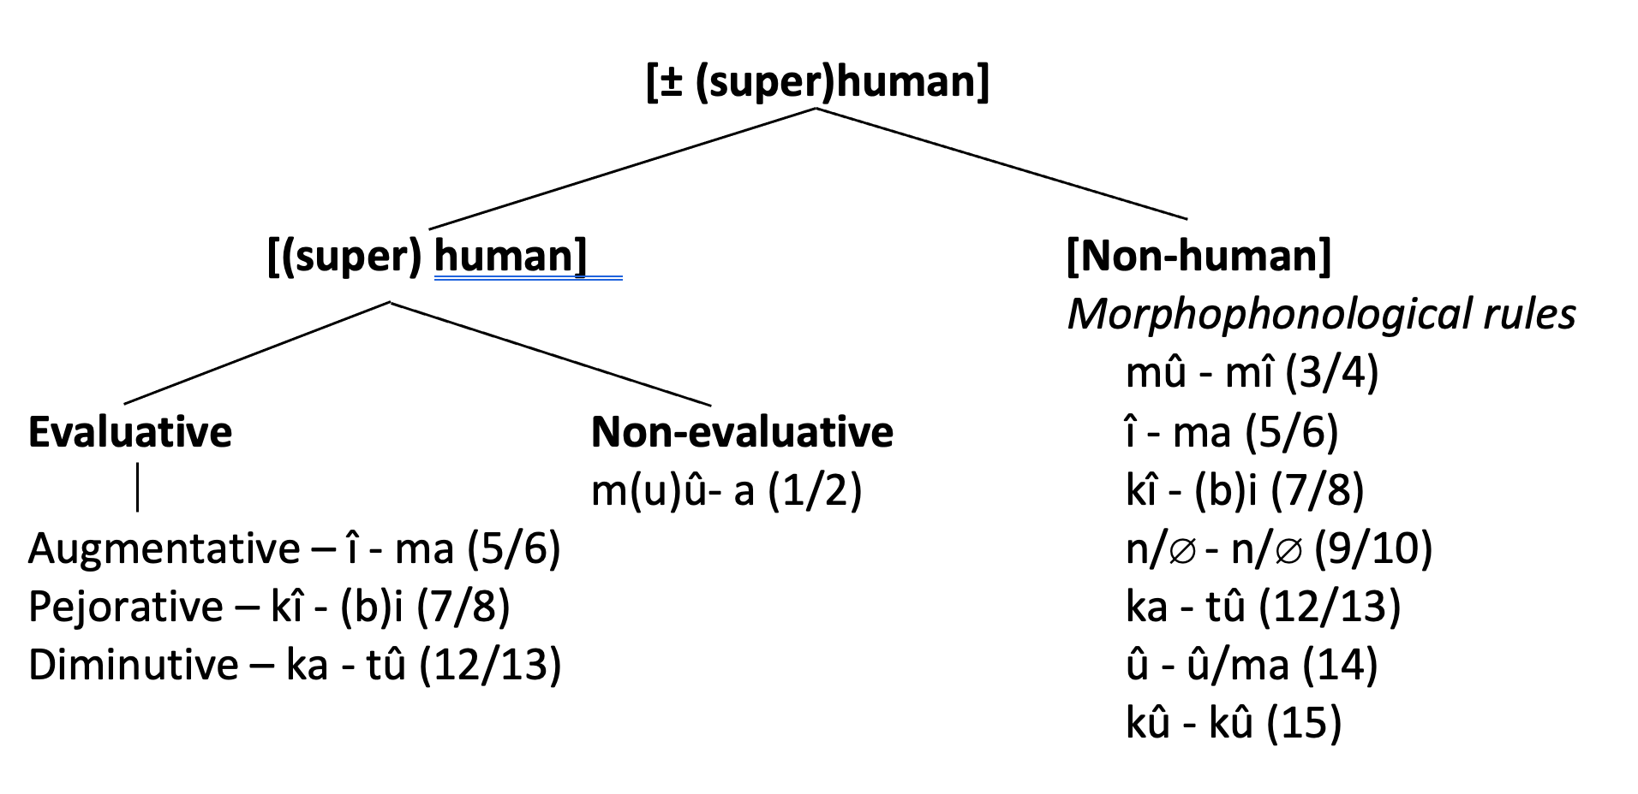
Implications: a possible schema
n – n (9/10)

Slide 24
Implications: a possible schema
 |  | Thing (most prototypical)
Evaluative |  |  |  | Non-evaluative
 |  |  | (Super)Human |  | Non-(super)human Morphophonological rules
 |  |  |  |  | û-î (3/4)
 |  |  |  |  | Î -ma (5/6)
 |  |  |  |  | K(g)î-k(g)î (7/8)

Slide 25
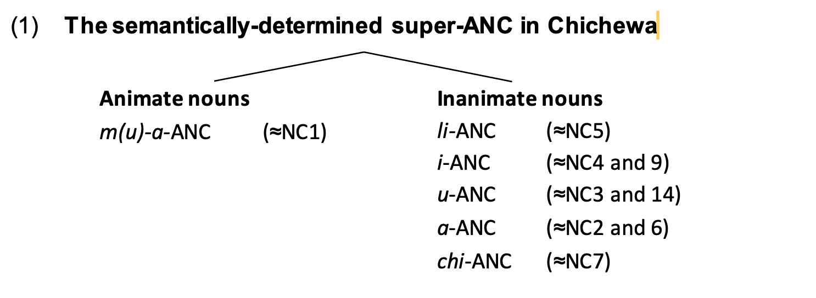
Implications: comparison with Chichewa
Two super-agreement noun classes (Msaka, 2019)
a) human/animate/agentive ~ animate
b) non-human/inanimate/non-agentive ~ inanimate

Slide 26
Corpus Limitations
Limited variety of written Kîîtharaka text- relied on Kîîtharaka bible (BTL, 2019)
  Bible lacked diversity on some semantic domains (e.g., names of local trees, local animals, body parts etc)
  Translated SIL comparative African word list (Snider & Roberts, 2006)
Tolerance Principle is a mere prediction of human behaviour
  Need for confirmation through experimenting with humans.

Slide 27
Next steps: Psycholinguistic experiments
Goals:
  Test TP predictions
    What semantic and morpho-phonological rules are speakers sensitive to when classifying novel nouns?
  What is the relative importance of semantic and morpho-phonological cues?
    Results of similar experiments outside Bantu: children learning noun classes prefer phonology cues even when statistically less reliable than semantic cues (as in Karmiloff-Smith, 1981; Gagliardi & Lidz, 2014 a.o.)

Slide 28
Conclusion
Noun classes are hard to understand…
  If approached from a diachronically centric point of view
  Without a theory of productivity, and without empirical evidence from speakers
A new approach that makes use of data from synchronic corpus and observation of human behaviour can help us better understand Kîîtharaka noun classes

Slide 29
The End
Thank you!

Slide 30
References
Aikhenvald, A. (2003). Classifiers: A typology of noun categorization devices. Oxford: Oxford University Press.
Amidu, A.A. 1997. Classes in Kiswahili. Köln: Rüdiger Köppe Verlag.
Bible Translation & Literacy (EA). (2019). Bibiria: Kîrîîkanîro kîra gîkûrû na kîrîîkanîro kîra kîyerû. Nairobi: Bible Translation & Literacy (EA).
Bleek, W.H.I. (1862-1969). A Comparative Grammar of South African Languages, I: Phonology (1862), II: The Concord, section I: The Noun (1869). London: Trubner. (Republished 1971 in one volume, Farnborough: Gregg.)
Brooks, P. J., Braine, M. D., Catalano, L., Brody, R. E., & Sudhalter, V. (1993). Acquisition of gender-like noun subclasses in an artificial language: The contribution of phonological markers to learning. Journal of Memory and Language, 32, 76–95.
Carstens, V., (1991). The morphology and syntax of determiner phrases in Kiswahili. UCLA PhD thesis.
Corbett, G.G. 1991. Gender. Cambridge Mass.: Cambridge University Press.
Demuth, K. (1992). Acquisition of Sesotho. In Slobin, D. (Ed.), The cross-linguistic study of language acquisition (Vol. 3, pp. 557–638). Hillsdale, NJ: Lawrence Erlbaum.
Demuth, K. (1994). On the ‘underspecification’ of functional categories in early grammars. In Lust, B., Suñer, M., Whitman, J. (Eds.), Syntactic theory and first language acquisition: Cross-linguistic perspectives (pp. 119–134). Hillsdale, NJ: Lawrence Erlbaum.
Demuth, K. (2000). Bantu noun class system: Loan words and acquisition. (G. Senft, Ed.) Classification Systems, 270-292.
Demuth, K., & Ellis, D. (2008). Revisiting the acquisition of Sesotho noun class prefixes. Mahwah, NJ: Lawrence Erlbaum.
Denny, J.P. & Creider, C.A. 1986. The semantics of noun classes in Proto-Bantu. In Noun classes and categorization. C. Craig, Ed. Amsterdam/ Philadelphia: John Benjamins Publishing Company.
Desrochers, A., Paivio, A., & Desrochers, S. (1989). L’effet de la fréquence d’usage des noms inanimés et de la valeur prédictive de leur terminaison sur l’identification du genre grammatical. Revue Canadienne de Psychologie, 43, 62–73.
Dixon, R. (1986). Noun classes and noun classification in typological perspective. In C. G. Craig (Ed.), Noun classes and categorization (pp. 105–112). Philadelphia, PA: John Benjamins.
Eberhard, David M, F. Simons and Charles, D. (2019). Kîîtharaka. (Fennigh, Ed.) Retrieved 09 28, 2019, from Ethnologue: Languages of the World: http://www.ethnologue.com
Frigo, L., & McDonald, J. (1998). Properties of phonological markers that affect the acquisition of gender-like subclasses. Journal of Memory and Language, 39, 218–245.
Gagliardi, A. and Lidz, J. (2014). Statistical insensitivity in the acquisition of Tsez noun classes. Language, 90(1):58–89..
Givón, T. (1971b). Historical syntax and synchronic morphology: an archaeologist's field trip. CLS. 7:394–415.
Guthrie, Malcolm (1967–71) Comparative Bantu: an introduction to the comparative linguistics and prehistory of the Bantu languages. 4 vols. Farnborough: Gregg Press.
Hockett, C. F. (1958) A Course in Modern Linguistics. New York: Macmillan. 1966. What Algonquian is really like. International Journal of American Linguistics 32:59-73
Msaka, P.(2019) Nominal classification in bantu revisited: The perspective from Chichewa. PhD dissertation: Stellenbosch University. Available at: http://hdl.handle.net/10019.1/107220

Slide 31
An overview of Tolerance Principle (TP)
TP offers a mechanism of establishing the productivity of linguistic rules in a set of items with exceptions by providing a threshold beyond which the exceptions should not exceed for the rule to be productive.
  Let rule R be defined over a set of N items. R is productive if and only if e the number of exceptions does not exceed 𝛉_{N.}
  (e ≤ 𝛉_{N} = N/ln(N) (Yang, 2016)
The threshold (Theta_N) is an expression of the time complexity involved in processing all the items in a non-productive rule. e.g, in a list of 100 items with 10 exceptions, the time taken is expressed as:
Productive rule = T (N, e) = T(100, 10)
Unproductive rule= T(N,N) = T(100, 100) (takes more time- each item is accessed and listed)
TP borrows substantially from two previous theories:
The Elsewhere Condition (Anderson, 1969; Aronoff, 1976)
  Exceptions are processed earlier than regulars
  Serial search- frequency sensitive (Stermberg, 1969; Forster, 1976)
Zipf’s Law (Zipf, 1949)
  Yang uses it to derive the tolerance threshold (A function of probability and time needed to access all items in a non-productive rule)
  The law states: The rank (r_{i}) and the frequency (f_{i}) of a word (w_{i}) in a corpus of natural language are inversely proportional (r_{i}f_{i} = C).

Slide 32
Experiment 1: Semantic Cues
Goal:
  Determine what semantic rules speakers are sensitive to when classifying nouns
  Test the predictions of the Tolerance Principle derived from our corpus
Method:
  Present unfamiliar images with semantic characteristics of interest, paired with nonce words
  Prefixes and agreement masked, participants produce them
Participants: Kîîtharaka speakers 18 and over

Slide 33
Experiment 2: Morphophonological Cues
Goal:
  Determine whether speakers sensitive to morpho-phonological cues in classifying nouns
  Test the predictions of the Tolerance Principle derived from our corpus
Method:
  Present nonce words with prefixes of interest
  Participants produce agreement in plural versions of the words
Participants: Kîîtharaka speakers 18 and over

Slide 34
Experiment 1: Contrasting Cues
Goal:
  Determine which cues (between semantics and morphophonology) speakers prime in classifying nouns
Method:
  Present unfamiliar images with semantic characteristics of interest, paired with nonce words
  Provide prefixes cuing a different class from image , participants produce agreement
Participants: Kîîtharaka speakers 18 and over

Slide 35
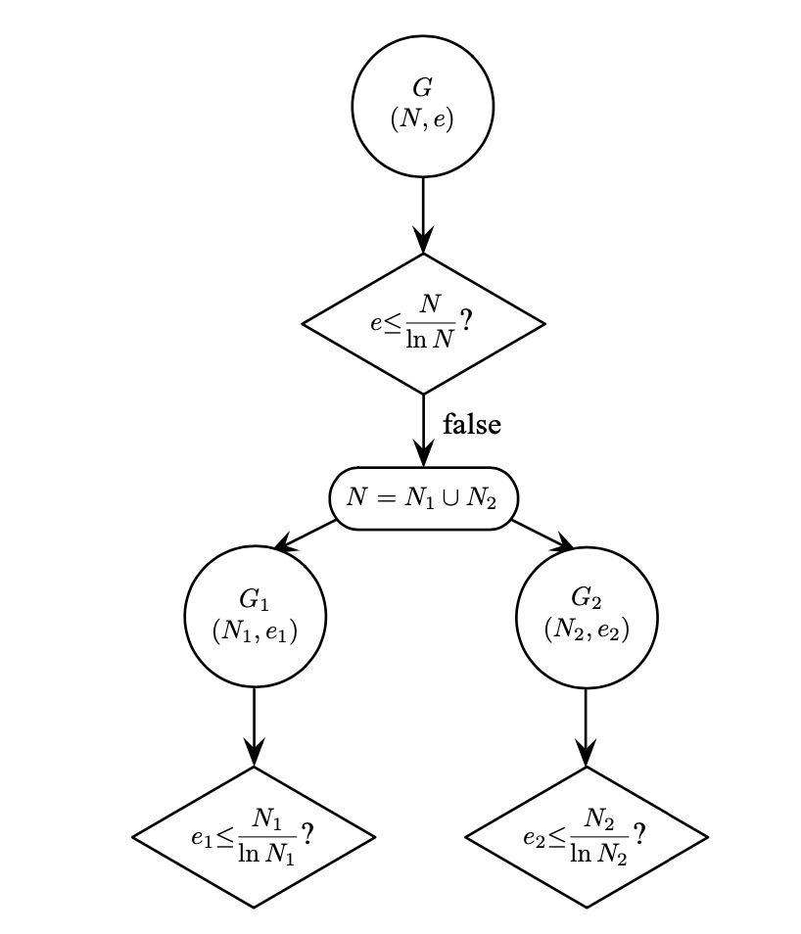
An overview of Tolerance Principle (TP)
Yang, 2016:104

Slide 36
Results: a productive semantic feature (class-feature mapping)
Class | Human | N | e | 𝛉_{N} | Productive?
1 | 198 | 198 | 0 | 37 | Yes
3 | 4 | 223 | 219 | 41 | No
5 | 2 | 177 | 175 | 34 | No
7 | 21 | 262 | 241 | 47 | No
9 | 22 | 428 | 406 | 71 | No
11 | 0 | 120 | 120 | 25 | No
12 | 6 | 81 | 75 | 18 | No
14 | 0 | 105 | 105 | 23 | No
15 | 0 | 684 | 684 | 105 | No

Slide 37
Results: a productive morpho-phonological feature
(class-feature mapping)
Class | Prefix | N | e | Theta_N | Productive?
1 | 162 | 198 | 36 | 37 | Yes
3 | 223 | 223 | 0 | 41 | Yes
5 | 172 | 177 | 5 | 34 | Yes
7 | 261 | 262 | 1 | 47 | Yes
9 | 337 | 428 | 91 | 71 | No
11 | 120 | 120 | 0 | 25 | Yes
12 | 81 | 81 | 0 | 18 | Yes
14 | 105 | 105 | 0 | 23 | Yes
15 | 675 | 684 | 9 | 105 | Yes

Slide 38
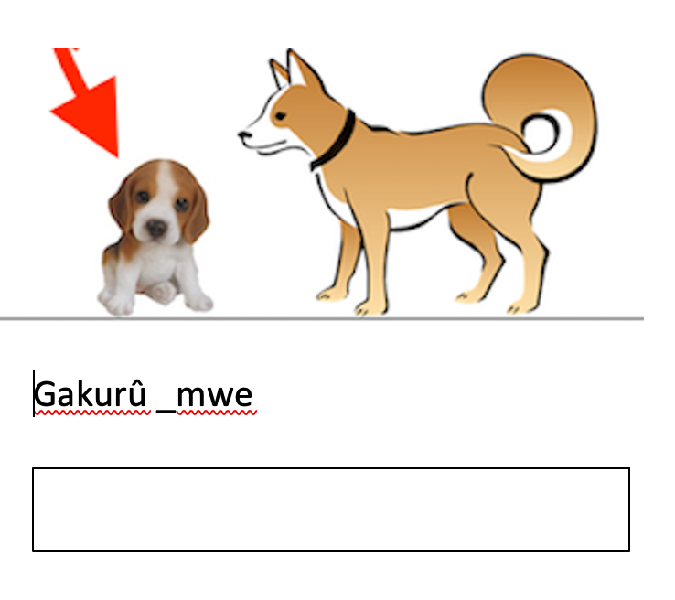
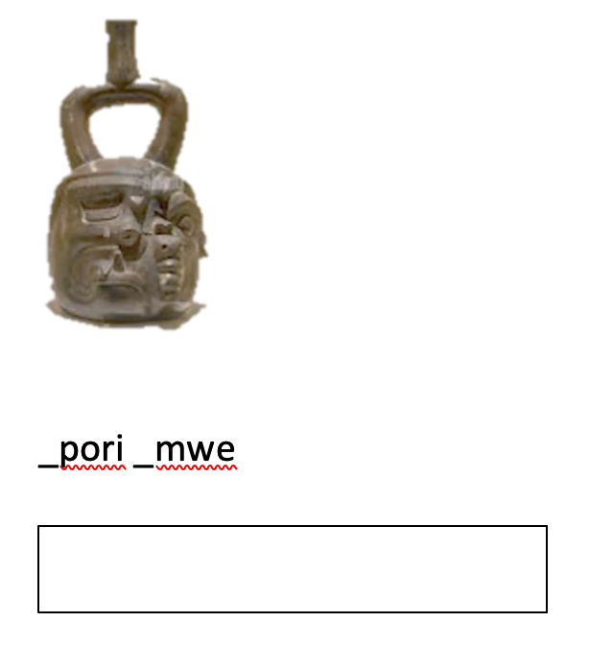
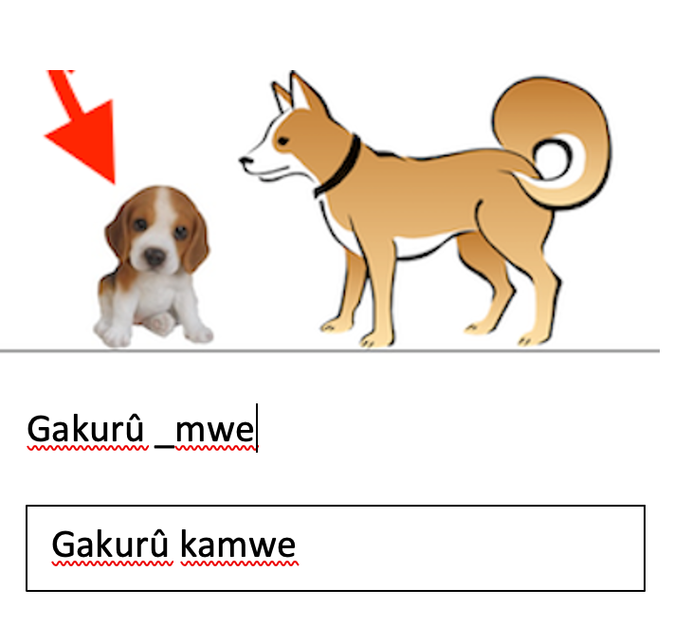
Sample Stimulus
Training Trial
Test Trial

